Slide 1
Bamboo crash barrier
A cost effective solution

Slide 2
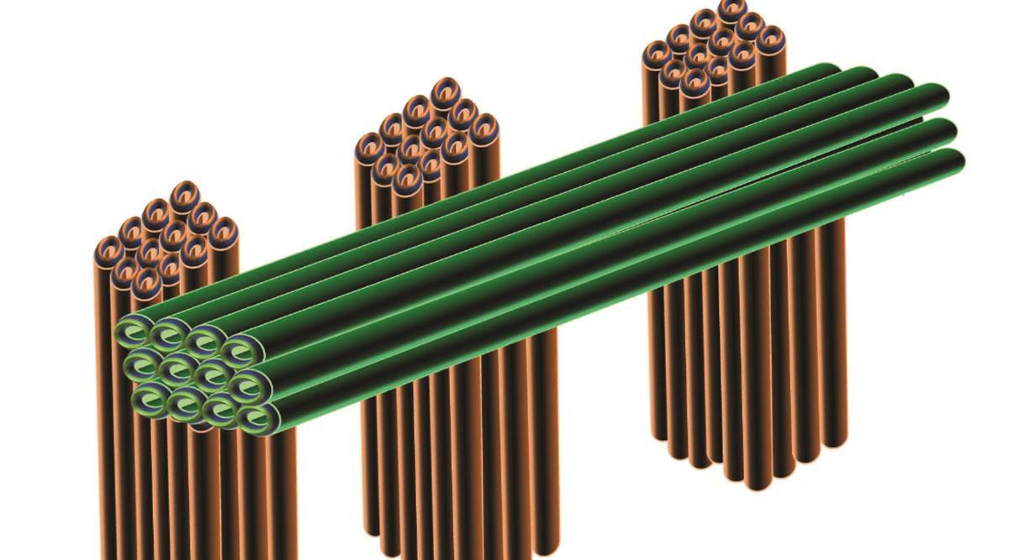

Slide 3
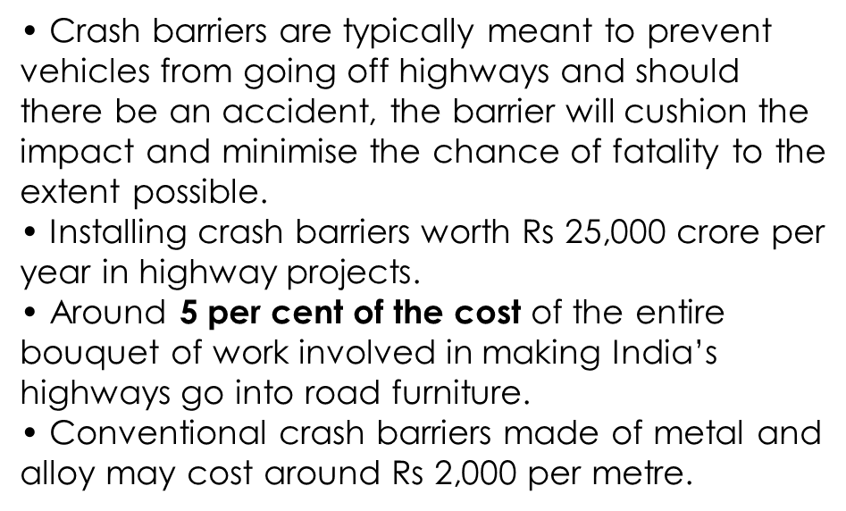
About Crash Barriers

Slide 4
Problem Statement
Accidental deaths on
highways because of getting
crashed into barriers.
Because of hardness of Steel
or Concrete barriers (which
are commonly used), body of
a person gets damaged
seriously after hitting it.
Existing crash barriers available in market are costlier, and because of which many of times road construction companies does not install them.

Slide 5
POTENTIAL SOLUTIONS :
There are several types of barriers we can use
1)Roller barriers
2)Flexible barriers
3)polymer based barriers
4)Semi-rigid barriers
5)Bamboo crash barriers

Slide 6
TARGET SOLUTION :
Target solution is to develop crash barriers which is made up of bamboos. Specifically Beema bamboo which is strong, durable, fast-growing, Cheap and tall clone of traditional bamboo.

Slide 7
SOLUTION POTENTIAL AREAS :
We can define solution potential areas on basis of maximum speed crash barrier can bear. Bamboo crash barrier can be suitable for vehicles with speed less than 100kmph. In India,
max speed limit on national highways: 100kmph
max speed limit for urban roads : 70kmph
Bamboo crash barriers can be used in these roads. Along with this bamboo crash barriers can be used in rural area roads and also in internal city roads.

Slide 8
Apart from crash barriers, Beema bamboo is recommended for
-Large scale plantation
-Energy plantation for power generations
-Homestead garden planting
-Large reforestation programs
-Land reclamation in mines, sodic soils, water logged areas etc.
Limitations:
Bamboo crash barriers cannot be used in expressways, because speed limit of expressways in India is 120kmph(which is more than permissible limit).

Slide 10
About Beema Bamboo
Beema or Bheema bamboo is a type of bamboo engineered to be a stronger, fast-growing and tall
clone of the traditional bamboo found in the Indian subcontinent, especially the North-East. This variety
grows well in southern India also.
• This cloned Bamboo is a superior clone, a higher Biomass yielding Bamboo species.
• It is thorn less, sterile, fast growing and High yielding superior bamboo.

Slide 11
If it is managed as per the Silvicultural methods it will higher Biomass on sustainable basis. Soil,
water requirement and climatic conditions are similar as sugarcane crop.
• Beema Bamboo acts as a Carbon
Sink and absorbs excess Carbon-di-oxide in the air three to four times than other trees.
• Obviously, it is eco-friendly and absorbs 400 to 500 Kg Carbon-di-oxide every year and grows five times faster than other spices of Bamboo.

Slide 12
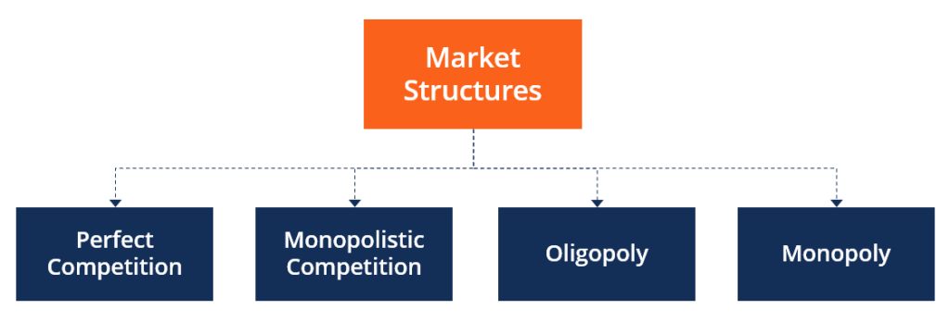
Market Structure
Market structure refers to how different industries are classified and differentiated based on their degree and nature of competition for goods and services. It is based on the characteristics that influence the behaviour and outcomes of companies working in a specific market.

Slide 13
In our case since the concept bamboos crash barrier is new and limited the type of market structure shall be Oligopoly where small no of companies shall sell / compete for similar product.
An oligopoly market consists of a small number of large companies that sell differentiated or identical products. Since there are few players in the market, their competitive strategies are dependent on each other.
As the business grows it is expected to go in Perfect Competition.
Perfect competition occurs when there is a large number of small companies competing against each other. They sell similar products (homogeneous), lack price influence over the commodities, and are free to enter or exit the market.
Consumers in this type of market have full knowledge of the goods being sold. They are aware of the prices charged on them and the product branding.

Slide 14
SWOT Analysis
Strength:
- Government in search of alternatives of existing crash barrier used
- Demand will be high once product gets enough marketing.
- Bamboo are hard and durable
- Labor cost is low
- Available government policy and strategies.
- Appropriate techniques/equipment and basic skills available.
- Appropriate techniques/equipment and basic skills available.
- Public Investment in development and dissemination of new technology.

Slide 15
Weakness:
- Struggling to meet deadlines - if work too much
- Holding too much stock can be problematic.
- Quality of material will degrade if stored for too much days.
- Product is bulky and transportation cost is high.
Opportunity:
- Good amount of capital can be obtained through Government schemes for MSME's.
- Similar products in markets like steel or any other metal crash barriers are more costlier.

Slide 16
Threats:
- Competitors with similar products will be there, some of them will be selling product at cheap price.
Competitors launching advertising camp.
Established players like China & Taiwan.
Poor treatment procedures may lead to loss.
Wastage of raw material during processing may lead to loss.

Slide 17
Financial Projections:
The Project is pilot project and for new highway construction purely for supplying, providing and erection of Bamboo Crash Barrier.
The target production is for 50,000 metre i.e. 50 kms per year and minimum production to achieve break even in two years -pessimistic condition is 15 kms of supply and erection of Bamboo crash Barrier each year .
The workshop and office is considered to be of 5000 sq.ft.
70% of Fund required shall be raised by MSME loans provided by Government of India under Udaymitra Scheme and 3 Lakhs from each group member of 8 or get a Capita Investor as explained in option -2 of capital arrangement.

Slide 18
COST ANALYSIS
Raw Material Cost Analysis
Case 1 | Cost Analysis for Purely Bamboo Railing Erection - Pilot Project
No | Description | Quantity | Unit |  | Rate | Amount
 |  |  |  |  | Rs | Rs
1 | Bamboo for 3 metre railing
 | V1 - 1x9 x7 + H1 & H2 -2x 3m x 9 | 240.12 | feet |  | 2.50 | 600
 | Coir 10% of Bamboo |  |  |  |  | 60
A |  |  |  |  | Subtotal | 660
 | Labour - 25% of A |  |  |  |  | 165
 |  |  |  |  | Total cost of Railing for 3 m | 825
Supply & Erection Cost of Only Bamboo Railing per running metre |  |  |  |  |  | 275

Slide 19
Set up Details
Item | Fixed cost (monthly) |  | Total Cost/Yr
 | Rs | Rs | Rs
Workshop + office lease | 50,000 |  | 600,000
Electricity | 8,333 |  | 100,000
Licencing | 2,500 |  | 30,000
 | A | Sub Total | 730,000
Equipment | One-time cost(Purchase) |  | Total Cost/Yr
Machine | Cutting Machine Assembling desk 2 nos | 300,000 | 300,000
Computers | 3 computers | 150,000 | 150,000
Sensors |  | 25,000 | 25,000
Security Cameras | 10 camera & NVR | 75,000 | 75,000
Office Equipment | Tables ,chairs & Cupboards | 200,000 | 200,000
AC |  | 100,000 | 100,000
Security Access Equipment |  | 10,000 | 10,000
Servers |  | 100,000 | 100,000
Production Tools |  | 75,000 | 75,000
Material Storage |  | 100,000 | 100,000
Special Software |  | 50,000 | 50,000
 | B | Sub Total | 1,185,000
 | Fixed Asset One time Cost | Total A + B | 1,915,000
 | Considering life span of 4 years
 | Fixed Cost per year for Balance sheet distributing for 4 years |  | 478,750

Slide 20
Expenses 1
 |  | Cost/Unit | unit | Units/Yr | unit |  | Total Cost/Yr
 | Considering production of 50,000 metre per year
A | Capital Cost
 | Raw materials & erection refer costing | 275 | per metre | 50,000 | m |  | 13,756,875
 | Miscellaneous supplies | 5 | per metre | 50,000 | m |  | 250,000
 | Special Materials | 5 | per metre | 50,000 | m |  | 250,000
 | Packing materials | 3 | per metre | 50,000 | m |  | 150,000
 | Logistic & transportation | 20 | per metre | 50,000 | m |  | 1,000,000
 |  |  |  |  | A | Sub Total | 15,406,875

Slide 21
Expenses - 2
B | Production - HR Variable Costs | Variable Costs |  | Fixed Costs
 |  | Months | Cost/Month | One-Time/Yr | Numbers | Total Cost/Yr
 | Production floor workers |  | 15,000 |  | 10 | 1,800,000
 | Maintenance team |  | 15,000 |  | 2 | 360,000
 | Quality specialists |  | 20,000 |  | 1 | 240,000
 | Consultants |  | 5,000 |  | 1 | 60,000
 | Security guards |  | 15,000 |  | 2 | 360,000
 | Sanitation staff |  | 13,000 |  | 1 | 156,000
 | Emp state insurance registration (4.5%) monthly |  |  |  |  | 133,920
 |  |  |  | B | Sub Total | 3,109,920

Slide 22
Expenses - 3
 | Sales & Mktg Variable Costs | Variable Costs |  |  | Fixed Costs
 |  | Months |  | Cost/Month | One-Time/Yr | Numbers | Total Cost/Yr
 | Salesperson salaries & wages |  |  | 15,000 |  | 3 | 540,000
 | Commissions /bonus |  |  | 5,000 |  | 3 | 180,000
 | Benefits |  |  |  |  |  | -
 | Promotional materials |  |  | 10,000 |  | 1 | 120,000
 | Advertisement campaigns |  |  | 25,000 |  | 1 | 300,000
 | Marketing agency commission |  |  | 3,000 |  | 1 | 36,000
 | Print media |  |  | 7,000 |  | 1 | 84,000
 | Social & online media |  |  | 5,000 |  | 1 | 60,000
 | Marketing salaries & fees |  |  | 25,000 |  | 2 | 600,000
 |  |  |  |  | C | Sub Total | 1,920,000
D | General Admin | Variable Costs |  |  | Fixed Costs
 |  | Months |  | Cost/Month | per month | Numbers | Total Cost/Yr
 | Security |  |  |  | 15000 | 2 | 360,000
 | Legal |  |  |  | 5000 | 1 | 60,000
 | Office Admin |  |  |  | 15000 | 3 | 540,000
 | Finance & Accounts |  |  |  | 15000 | 2 | 360,000
 | Medical (if reqd) |  |  |  | 5000 | 1 | 60,000
 |  |  |  |  | D | Sub Total | 1,380,000

Slide 23
Expense 4
E | Other Expenses | Months |  | Cost/Month | per month | Numbers | Total Cost/Yr
 | Insurance |  |  |  | 25000 | 1 | 25,000
 | Shipping |  |  |  | 8000 | 1 | 96,000
 | Network Connectivity |  |  |  | 1000 | 1 | 12,000
 |  |  |  |  | E | Sub Total | 133,000
 |  |  |  | Running cost per year |  |  | 21,949,795
 |  |  |  | Running cost per metre |  |  | 439
 | Capital required for start up for six months until inflow of revenue starts @ 50% |  |  |  |  |  | 10,974,898
 | Expenses arrangement for production & back office for six months – A to E |  |  |  |  |  | 10,974,898
 |  |  |  | Fixed Asset one time cost |  |  | 1,915,000
 | Capital required for start up to sustain till inflow of revenue for six months |  |  |  |  |  | 12,889,898
 |  |  |  | Total Inivital Investment - first year |  |  | 23,864,795
 | Total expense for second year considering 5% appreciation on running cost |  |  |  |  |  | 23,047,285
 | Total expense for Third year considering 5% appreciation on running cost |  |  |  |  |  | 24,199,649
 | Total expense for Fourth year considering 5% appreciation on running cost |  |  |  |  |  | 25,409,631

Slide 24
Revenue & Expenses
Revenue `
Period | Selling price / unit | No. of units sold | unit | Total Revenue/Yr
Year 1 | 550 | 50,000 | metre | 27,500,000
Year 2 | 600 | 50,000 | metre | 30,000,000
Year 3 | 650 | 50,000 | metre | 32,500,000
Year 4 | 700 | 50,000 | metre | 35,000,000
Expenses
Year 1 | Capital+ Running cost of full year |  |  | 23,864,795
Year 2 | Running cost of second year | 5 % appreciation on first year |  | 23,047,285
Year 3 | Running cost of Third year | 5 % appreciation on 2nd year |  | 24,199,649
Year 4 | Running cost of Fourth year | 5 % appreciation on 3rd year |  | 25,409,631
 | Net Profit before Tax | 1st year |  | 3,635,205
 | Net Profit before Tax | 2nd year |  | 6,952,715
 | Net Profit before Tax | 3r year |  | 8,300,351
 | Net Profit before Tax | 4th year |  | 9,590,369
 |  | Profit % first year |  | 15.23 | %
 |  | Profit % 2nd year |  | 30.17 | %
 |  | Profit % 3rd year |  | 34.30 | %
 |  | Profit % 4th year |  | 37.74 | %

Slide 25
Capital – option1
No | Amount | Source/comments
 | Rs
1 | 1,915,000 | Total Capital Required for set up
2 | 10,974,898 | Total Capital Required for initial running up to six months till revenue starts getting generated
Capital Required | 12,889,898
Capital arrangement
3 | 3,200,000 | 4 Lakhs from each partner of 8
4 | 9,625,000 | Through Govt Scheme MSME=70 % of order of 25 kms
Capital arrangement | 12,825,000
Since Capital Required<Capital arrangement , Hence OK.

Slide 26
Capital -2
No | Amount | Source/comments
 | Rs
1 | 1,915,000 | Total Capital Required for set up
2 | 10,974,898 | Total Capital Required for initial running up to six months till revenue starts getting generated
Capital Required | 12,889,898
Capital arrangement
3 | 3,200,000 | 4 Lakhs from each partner of 8
4 | 5,600,000 | Capital partner - Shall receive 35% of net profit earned , no interest to be paid for capital blocked
5 | 4,125,000 | 0.30 x550 X25000 - Advance from Client for 50% of target
Capital arrangement | 12,925,000
Since Capital Required<Capital arrangement , Hence OK.

Slide 27
Revenue & Break Even Analysis
 | Revenue
 | Period | Selling price / unit | No. of units sold | unit | Total Revenue/Yr
 | Year 1 | 550 | 50,000 | metre | 27,500,000
 | Year 2 | 600 | 50,000 | metre | 30,000,000
 | Year 3 | 650 | 50,000 | metre | 32,500,000
A | Break even Analysis if target of 50,000 metre per year is meet - Optimistic
 |  | Expenses for first year
 |  | Expenses | Fixed set up |  | 1,915,000
 |  | Running | Cost first year |  | 21,949,795
 |  |  |  | Total Exp | 23,864,795
 |  | Revenue of first year | 50,000X550 |  | 27,500,000
 |  |  | Difference |  | 3,635,205
Since difference is positive , Break even will happen in first year only if full target is met

Slide 28
Risk Analysis
 | RISK ANALYSIS - FINANCIAL - if 30% order is meet
B | Break even Analysis - If target of 15000 metre per year is meet - Pessimistic
 |  | Expenses for first year
 |  | Expenses | Fixed set up |  | 1,915,000
 |  | Expenses | Running |  | 6,584,939
 |  |  | Total Exp |  | 8,499,939
 |  | Income of first year |  |  | 8,250,000
 |  |  | Difference |  | - 249,939
 |  | Since difference is negative , Break even will not happen in first year
 |  | Second Year | 15000 metre
 |  | Running expense - 5 % escalation | 1.05X Rs65,84,939 |  | 6,914,185
 |  | Income in second year |  |  | 9,000,000
 |  | Difference Income - expense | 15000x Rs600 |  | 2,085,815
 |  | Adding loss off first year |  |  | - 249,939
 |  |  | Profit without Tax |  | 1,835,876
 |  | Hence in Pessimistic scenario also break even will happen in second year

Slide 29
Internal Rate of Return - IRR
Case 1 - Discounting Factor -10 %
Year | Initial Investment | Cash In flow | DF |  | PV
 |  |  | 10%
0 |  | - 23,864,795 | 1 |  | -23,864,795
1 |  | 3,635,205 | 0.97 |  | 3,526,149
2 |  | 6,952,715 | 0.942 |  | 6,549,458
3 |  | 8,300,351 | 0.915 |  | 7,594,821
4 |  | 9,590,369 | 0.878 |  | 8,420,344
 |  |  | NPV - L |  | 2,225,976 | A
Case 2 - Discounting Factor -12 %
Year | Initial Investment | Cash In flow | DF |  | PV
 |  |  | 12%
0 | - 23,864,795 |  | 1 |  | -23,864,795
1 |  | 3,635,205 | 0.892 |  | 3,242,603
2 |  | 6,952,715 | 0.797 |  | 5,541,314
3 |  | 8,300,351 | 0.711 |  | 5,901,550
4 |  | 9,590,369 | 0.635 |  | 6,089,884
 |  |  | NPV -H |  | - 3,089,444 | B
 | IRR= | L+(A/A-B)x(H-L) | By Interpolation
 | = | 10+(22.59/22.59+30.89)x(12-10)
 | IRR | 10.84 | %
 | Hence IRR =10.84%

Slide 30
Technical Risk Analysis –
Since its pilot project and of limited target of 50 kms per year , the chances of project failing on firms technical grounds are quite low.
The only chance of complete failure is when the government scraps the bamboo crash barrier project due to its technical failure to withstand the impact of fast moving vehicle.
The capital at stake at this stage shall be Rs 19 lakhs accounted for set up as all other expenses are accounted post receipt of confirmed order.
In that case new avenue such compound bamboo fencing and bamboo decorative furniture works can be started

Slide 31
Market Risk Analysis –
Interest Rate Risk is not applicable for capital arrangement2 as we are arranging funds from partner on profit basis and not on interest base.
For capital arrangement- 1 since its MSME interest rates are nominal and can be manged .
Commodity Risk is also low as ample of bamboo is available as per Government schemes.

Slide 32
Future Potential –
If the pilot project succeeds and GOI implements Bamboo Crash Barrier work on full scale the future potential are exciting.
The future potential of Bamboo in allied field are also good such as compound fencing etc as its economical ,reduce carbon foot print and economical.
It also has future potential in decorative and interior industry.

Slide 33
References:
https://pib.gov.in/PressReleasePage.aspx?PRID=1670354
https://www.transcontinentaltimes.com/2021/02/02/beema-bamboo-a-magic-wand-solution-to-reduce-road-mishaps
https://indianexpress.com/article/india/in-bamboo-clone-crash-barriers-a-cost-effective-road-safety-solution-7168281
https://www.indiatimes.com/trending/social-relevance/steel-barrier-bamboo-replacement-533411.html
https://www.youtube.com/watch?v=lpZma_jV2gY

Slide 34
Thank You

